Slide 1
STRESS ECHOCARDIOGRAPHY
DR. RANJITH
SR CARDIOLOGY
MCH CALICUT

Slide 2
Stress echocardiography
Indication
Coronary artery disease
Valvular heart disease
First line test in patients with baseline ECG abnormalities – that preclude interpretation of exercise ECG

Slide 3
Coronary artery disease
Detection of CAD
Localisation of coronary artery lesion
Post MI- Risk assessment
After revascularisation
Viability assessment
Preoperative evaluation

Slide 4
Coronary artery disease
Causal relationship between induced myocardial ischemia and left ventricular wall motion abnormalities
Stress → Increased HR and contractility → increased myocardial blood flow → hypercontractile response with increased EF

Slide 5
Stress echo- cad
Most common application- Detection of flow limiting stenosis
Based on sequence of events - Ischemic cascade
Normal coronary arteries adapt to stress by coronary vasodilatation (coronary flow reserve)—to meet the increased oxygen demand
In the presence of flow limiting coronary stenosis- coronary flow reserve is impaired- resulting in ischemic cascade

Slide 6
ISCHEMIC CASCADE
Chest pain
ECG changes
Ischemia
Systolic abnormality
Diastolic abnormality
Perfusion abnormality
Metabolic abnormality
Duration

Slide 7
Cad detection
Segmental wall motion abnormality- reduction in systolic thickening and endocardial excursion

Slide 8
TYPES OF STRESSORS
EXERCISE STRESS | NON EXERCISE STRESS
Treadmill | Dobutamine
Supine bicycle | Dipyridamole
Upright bicycle | Adenosine
Handgrip | Pacing
Stair step

Slide 9
TREADMILL STRESS ECHO PROTOCOL
Prepare patient
Obtain rest echo images
Perform standard TMT
Pt moves as soon as possible after exercise to examination table.
Post exercise images acquired and recorded
Both set of images are compared

Slide 10
information obtained from exercise stress echo
Exercise capacity
Reproducibility of symptoms with activity
Heart rate and BP response to exercise
Detection of stress induced Arrhythmias
Control of angina on OMT

Slide 11
EXERCISE STRESS ECHO
TREADMILL
Advantages
Widely available
Relatively simple protocols
Preserves the additional information already available from TMT.
Disadvantages
Imaging is restricted to the immediate post exercise period.
The ischemia may resolve quickly and hence the window for image acquisition is small. ( 1 to 1.5 minutes)

Slide 12
SUPINE BICYCLE ERGOMETRY
Patient positioned on a supine bicycle ergometer with roughly 30⁰ head up tilt.
Rest images obtained
Exercise started at a workload of 25 W and a cadence of 60 rpm.
Workload is increased by 25 W every 2 minutes
Images obtained throughout exercise and at peak exercise.
After exercise images are obtained to look for normalization of WMA

Slide 13
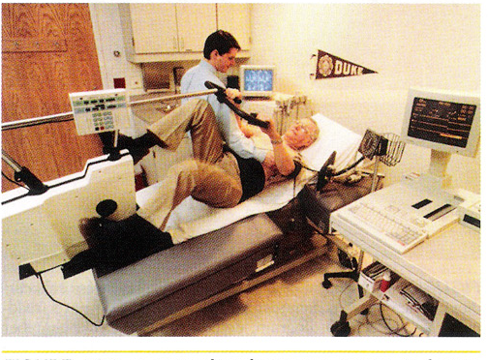

Slide 14
Supine bicycle
Advantage
Imaging possible through out the exercise-especially peak exercise.
Onset of RWMA
Better image quality
Applying contrast easier
Disadvantage
Lower work load acheivable
Supine position affects exercise physiology

Slide 15
Why pharmacological stress echo
Hyperventilation
Hypercontractility of Normal Walls
Excessive Tachycardia
Excessive chest wall movement
Unable to exercise at all or maximally

Slide 16
DOBUTAMINE STRESS ECHO
DOBUTAMINE
A synthetic catecholamine
Ionotropic and chronotropic effects
Acts on β1 and β2 receptors
Ionotropic effect at lower doses and more of chronotropic effect at increasing doses.
Net effect is an increase in contractility, heart rate and myocardial oxygen demand

Slide 17
PROTOCOL FOR DOBUTAMINE STRESS ECHO
Patient is prepared
4 hrs fasting
All negative ionotropic and chronotropic agents held for 8 to 12 hrs.
I.V access obtained.
Baseline images obtained
Continuous ECG and BP monitoring established
Dobutamine infusion started @ 5 or 10 µg/kg/min.
Rate increased every 3 minutes to doses of 10,20,30 and 40 µg/kg/min

Slide 18
Atropine can be given at a dose of 0.5 to 1.0 mg during mid and high dose stages
-If THR not achieved
-Max dose 2mg
Peak images obtained just before termination of infusion.
Post stress images obtained after return to baseline.
Patient to be monitored till return to baseline.
A trial dose of 50 µg/kg/min maybe used if near THR achieved at 40.

Slide 19
Dobutamine dose calculation
1 ampule = 5 ml
1ml= 50 mg
2 amp in 50 ml (500mg in 50 ml)
1 ml = 10 mg
5 mcg/kg/min= 5*60*60=18000 mcg=18 mg
5 mcg/kg/min= 2 ml/hr

Slide 20
Protocol for Dobutamine Stress Echo.

Slide 21
INDICATIONS TO TERMINATE DOBUTAMINE INFUSION DURING STRESS ECHO
1.Exceeding THR of 85% age predicted maximum.
2.Development of significant angina.
3.Recognition of a new wall motion abnormality.
4.A decrease in SBP > 20 mm Hg from baseline.
5.Sustained or symptomatic arrhythmias.
6.Limiting side effects or symptoms.
7.Severe HTN ( > 220/120 mmHG)

Slide 22
SAFETY
Safety has been studied extensively
Short t_{1/2} (2 minutes) -- induced ischemia readily reversed by termination of infusion.
Severe cases - short acting i.v β Blocker- Esmolol or Metoprolol can be used
Overall rate of life threatening events- 1/1000
Freq complication- acute MI, VT, VF

Slide 23
limitations
False negative- suboptimal stress, limited image quality, small area of ischemia
Challenging- LBBB, postoperative state, pacing
other- HCM, cardiomyopathy, hypertension

Slide 24
Other pharmacological agents
Vasodilators
Adenosine
Dipyridamole

Slide 25
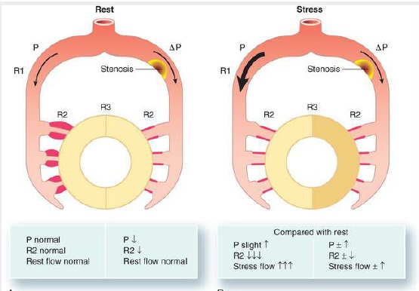
Vasodilator effect on stenosed vessel

Slide 26
INTERPRETATION OF STRESS ECHO
17 segment model
Normal ventricle-hypercontractile with stress and cavity size shrink
HYPERKINESIS – normal response to stress
Lack of Hyperkinesis:
Myocardial ischemia
Non –ischemic CMP.
Beta blocker therapy
Severe hypertension
Delay in image acquisition

Slide 27
Volume response
Decrease in ESV and EDV – Normal response
25-30% decrease in ESV and EDV is the normal response.
An abnormal volume response is defined as an increase in volume from rest to stress of > 17%.

Slide 28
Contrast echo
If endocardial resolution is poor in 2 or more segments- IV echo contrast enhancement

Slide 29
RWMA
AT REST | AT STRESS
INFARCTION | ISCHEMIA
CARDIOMYOPATHY | TRANSLATIONAL CARDIAC MOVEMENT
MYOCARDITIS | MARKEDLY INCREASED BP
LBBB | CARDIOMYOPATHY
HYPERTENSION | RATE DEPENDENT LBBB
HIBERNATING MYOCARDIUM | PULMONARY HYPERTENSION
STUNNED MYOCARDIUM
TOXINS
POSTOPERATIVE STATE
PACED RHYTHM
RV VOLUME / PRESSURE OVERLOAD

Slide 30
Wall motion response
Rest | Stress | Interpretation
Normal | Hyperkinetic | Normal
Normal | Hypokinetic/akinetic | Ischemia
Akinetic | Akinetic | Infarction
Hypokinetic | Normal | Viable
Hypokinetic | Akinetic/dyskinetic | Ischemia/infarction

Slide 31
Interpreting stress echo
A large ischemic territory (left main or multivessel disease) -- diminished global LVEF and chamber dilation with stress

Slide 32
Risk stratification
Patients who complete normal exercise or pharmacologic stress echo (reaching good exercise capacity and the target heart rate)-- the risk for cardiac events is very low and close to that of a normal population
<1%/ year for exercise and <2% / yr for pharmacologic tests

Slide 33
ASSESMENT OF MYOCARDIAL VIABILITY
The term viable refers to myocardium that has the potential for functional recovery.
The resting Echo is neither sensitive nor specific
The BIPHASIC RESPONSE -- augmentation at low dose followed by deterioration at higher doses is most predictive of the capacity for functional recovery.
Any improvement in wall motion abnormality by at least one grade in two or more segments during stress is likely to signify viability

Slide 34
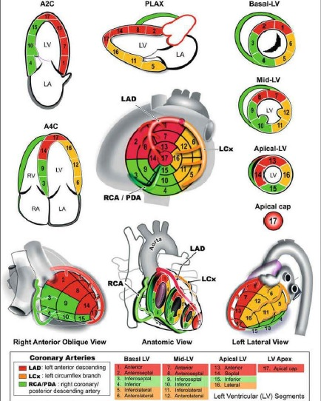

Slide 35
STRESS ECHO AFTER MI
Used both to identify high and low risk subsets and to predict the location and extent of CAD.
The goal is to identify ischemia at a distance
Positive finding would be detection of a new WMA remote from the site of previous infarction.
Inducible ischemia is a powerful indicator of high risk and suggests the need for further evaluation.

Slide 36
Preoperative Risk Assessment
Most studies used dobutamine stress.
Mainly before major peripheral vascular surgery and therefore included patients who frequently are unable to exercise.
In this high-risk subset, the presence or absence of an inducible WMA has been the most potent determinant of relative risk.
The absence of an inducible wall motion abnormality confers a very favorable prognosis, with a negative predictive value of 93% to 100%.

Slide 37
STRESS ECHO IN VALVULAR HEART DISEASE
Aortic Stenosis
The principal role of exercise testing is to unmask symptoms or abnormal blood pressure responses in patients with AS who appear to be asymptomatic.

Slide 38
LOW FLOW LOW GRADIENT AS
Anatomically severe AS and LV systolic dysfunction (EF<40%) often presents with a relatively low-pressure gradient, such as a mean gradient of 30 to 40 mm Hg or less

Slide 39
LOW FLOW LOW GRADIENT AS
DSE can be used to assess both the true severity of AS and the amount of LV contractile reserve
Dobutamine is infused in graded doses from 5 to 20 μg/kg/min
spectral Doppler of the LVOT and CW Doppler across the aortic valve
SV is calculated from VTILVOT.
An increase of 20% or higher in SV is indicative of significant contractile reserve.
The test is indeterminate if little or no augmentation of LV function takes place (no contractile reserve, or SV <20%).

Slide 40
Aortic valve area is calculated at both baseline and with dobutamine
True AS -- the ratio of aortic/LVOT velocity will increase
Pseudosevere or functional AS- the LVOT and aortic gradients change relatively little, and the calculated valve area remains the same or increases

Slide 41
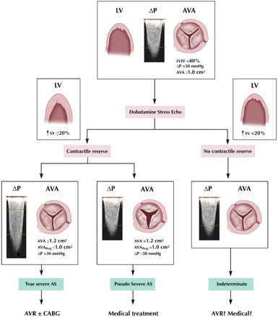

Slide 42
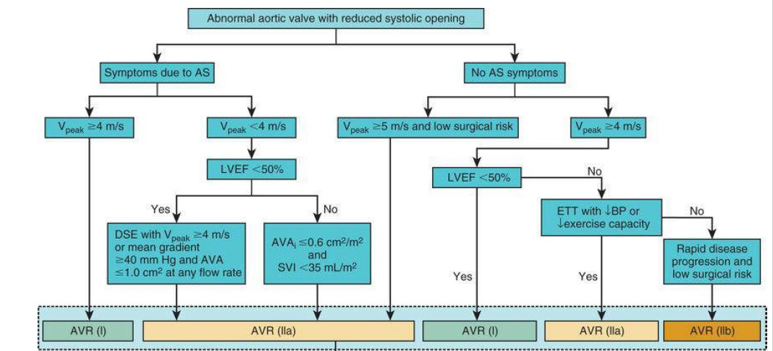
Aortic stenosis management

Slide 43
Mitral stenosis
Patients with mitral stenosis (MS) may have severe exertional symptoms despite relatively modest gradients on the resting echocardiogram.
Conversely, sedentary patients with severe MS may be relatively asymptomatic because they are inactive.
Valve gradients -- dependent on the flow rate and heart rate

Slide 44
Mitral stenosis
Stress echocardiography can define the true exercise capacity and quantitate the degree of valvular stenosis and regurgitation.
A rise in the mean transmitral pressure gradient greater than 15 mm Hg or an increase in calculated pulmonary artery systolic pressure greater than 60 mm Hg is correlated with significant MS and consider BMV

Slide 45
Mitral stenosis
In asymptomatic patients with severe MS (mean gradient >10 mm Hg and mitral valve area [MVA] <1.5 cm²) or
Symptomatic patients with moderate MS (mean gradient of 5 to 10 mm Hg and MVA > 1.5 cm²)

Slide 46
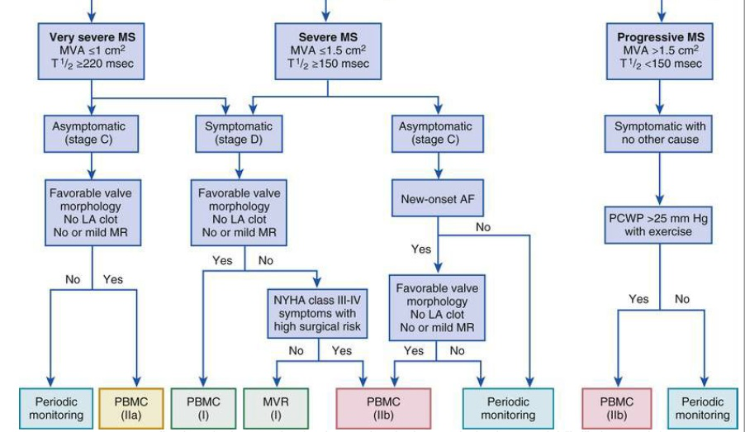
Mitral stenosis management

Slide 47
Mitral regurgitation
In patients with MR --stress echo useful in revealing acute reversible ischemic MR caused by inferior wall ischemia
usually associated with stress-induced inferior wall motion abnormalities and improvement in both abnormalities during recovery.
In chronic severe MR, even if the LVEF is preserved, demonstration of a rise in PASP> 60mmHg with exercise and reduced LV contractile reserve -- indications for mitral valve surgery

Slide 48
Other indications
Hypertrophic cardiomyopathy – exercise can bring out latent gradients and assess symptoms such as syncope
Diastolic dysfunction
Prosthetic valve gradient

Slide 49
THANK U

